Slide 1

Diabetes Progression Prediction
Data Science Methodology and Clinical Insights
LINEAR REGRESSION ANALYSIS

Slide 2
Project Overview
Defining clinical objectives and physiological parameters

Slide 3

Predictive Clinical Modeling
Objective
The primary goal is to predict a quantitative measure of disease progression one year after baseline.
By analyzing patient measurement data, we identify key risk factors and establish a reliable statistical baseline for healthcare providers.

Slide 4
Dataset Feature Schema
Category | Features | Description
Demographics | Age, Sex | Normalized baseline attributes
Physical | BMI, Blood Pressure | Core physical measurements
Serum Markers | s1, s2, s3, s4, s5, s6 | Six blood serum lab results
Sample Size | 442 Patients | Validated clinical cohort

Slide 5
Exploratory Data Analysis
Uncovering statistical relationships and trends

Slide 6
Statistical Data Profiling
Clean Data Ingestion: Verification of 442 samples across 10 validated clinical columns with zero missing values.
Normalized Scale: Features are mean-centered and scaled by standard deviation times the square root of n_samples.
Target Range: One-year progression scores range from a minimum of 25 to a maximum of 346.

Slide 7
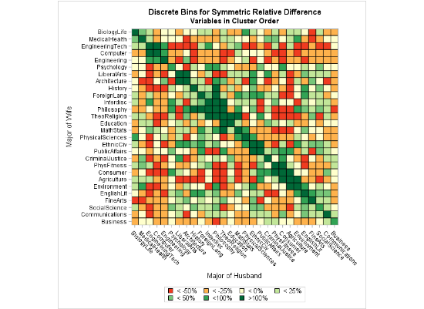
Feature Correlation Matrix
Key Drivers
BMI (0.59) and Serum_s5 (0.57) show the highest positive correlation with disease progression.
Serum_s3 (-0.39) exhibits a notable inverse relationship, serving as a significant negative clinical indicator.

Slide 8
Predictive Pipeline
Linear Regression training and validation

Slide 9
Model Performance Metrics
0.45
42.8
53.9
R-SQUARED (R²)
MEAN ABS ERROR
RMSE
The model captures approximately 45% of the variance in disease progression based on baseline clinical markers.

Slide 10
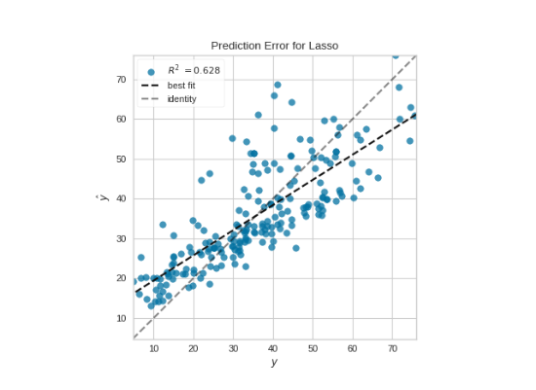
Actual vs. Predicted Validation
Regression Accuracy
The visual analysis of the validation set shows consistent predictive power across the score spectrum.
Data points cluster around the identity line, confirming the model's reliability for general progression trends.

Slide 11






Top Clinical Determinants
Serum s5
BMI
Serum s1
Impact: +736.2
Impact: +542.4
Impact: -931.5
Highly significant positive clinical marker for progression.
Primary physical indicator with strong linear predictive weight.
Strongest negative coefficient, suggesting a protective role.

Slide 12
THANK YOU

